Slide 1



Integration and Persistence
ACC
ICS
JCS
DBaaS
SOA CS
Compute
Compute
JCS
Storage
Storage
DBaaS
Compute
Storage

Slide 2
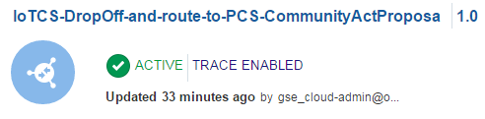
ICS is at the center of this world
REST
(hand off artist finding in proprietary IoT CS JSON format); forwarded to PCS
IoT CS
ICS
PCS

Slide 3
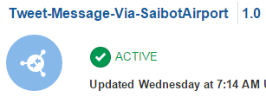
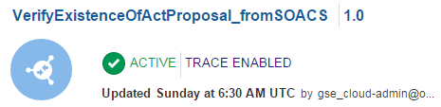
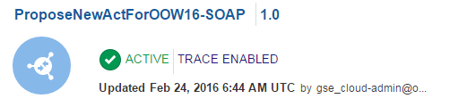
ICS is at the center of this world
REST
(publishes a Tweet, called from SOA CS)
IoT CS
SOAP
(returns Y or N depending on whether a proposal exists using SOA CS)
REST
(hand off artist finding in proprietary IoT CS JSON format); forwarded to PCS
ICS
SOA CS
PCS
SOAP
(calls to SOA CS to create enriched proposal in DB; this service is to be called by PCS)

Slide 4
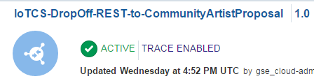
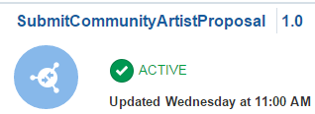
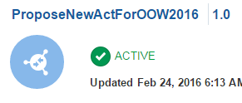
ICS is at the center of this world
REST
(publishes a Tweet through SaibotAirport )
REST
(hand off artist finding in proprietary IoT CS JSON format); forwarded to SOA CS
SOAP
(returns Y or N depending on whether a proposal exists using SOA CS)
IoT CS
ICS
REST
(hand off artist finding in proprietary IoT CS JSON format); forwarded to PCS
SOA CS
REST
(submit a proposal for an artist in decent JSON format; links to PCS to ask for approval of the proposal
SOAP
(calls to SOA CS to create enriched proposal in DB; this service is to be called by PCS)
PCS
REST API
(calls to SOA CS to create enriched proposal in DB)

Slide 5
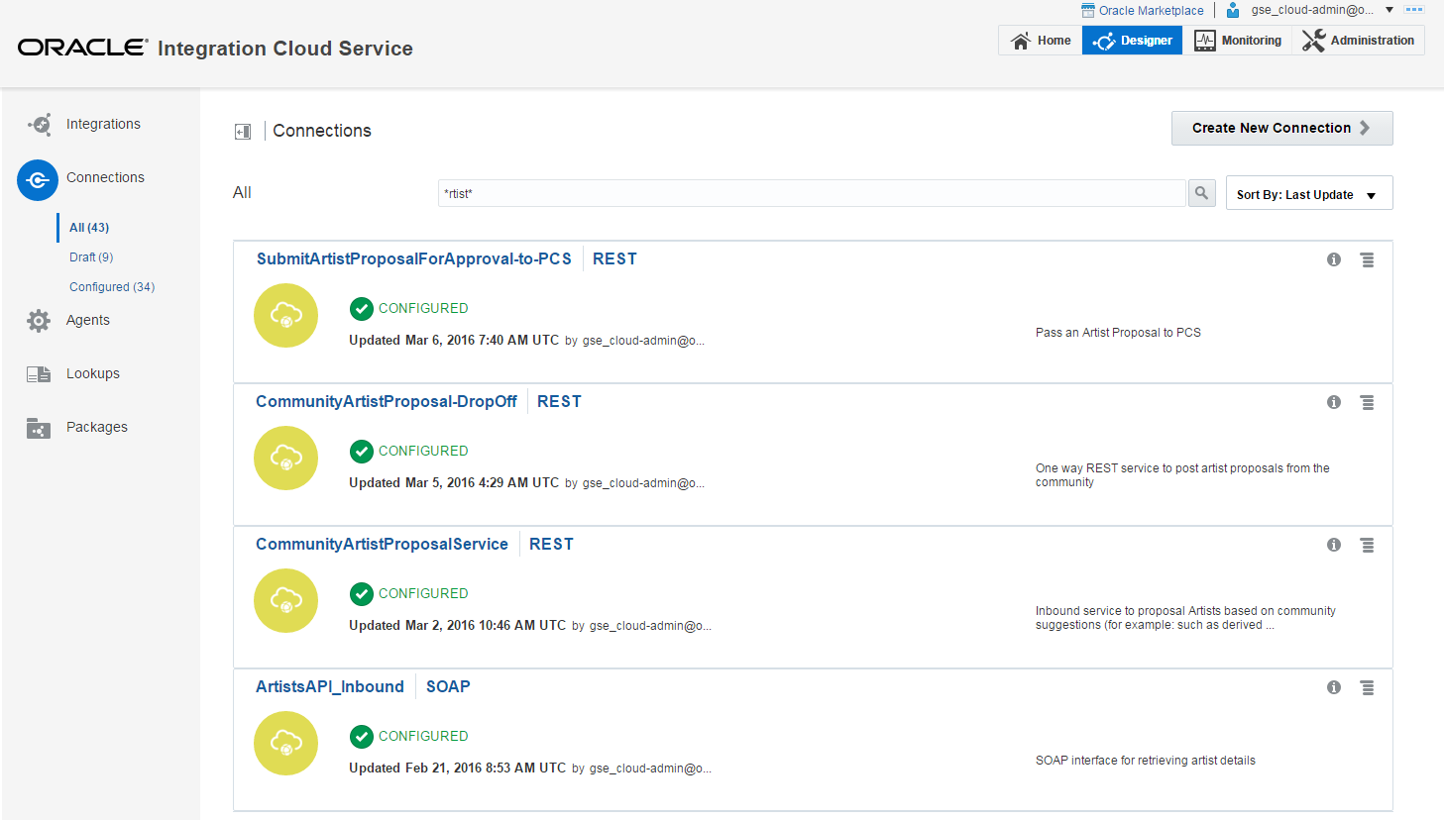
Defining Connections

Slide 6
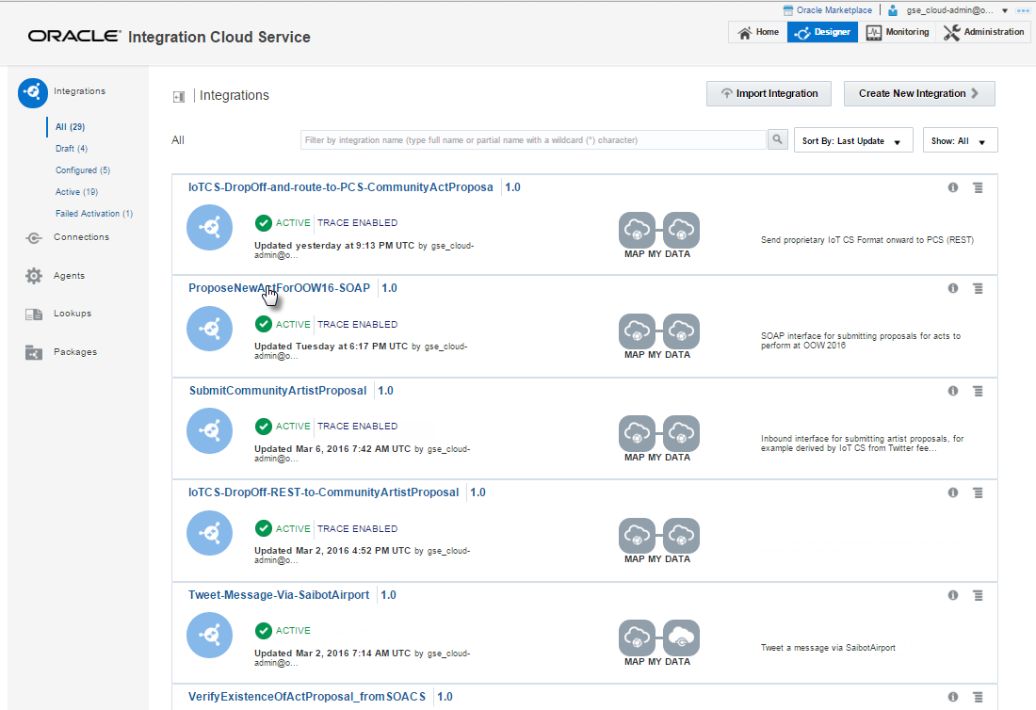
Defining Integrations

Slide 7
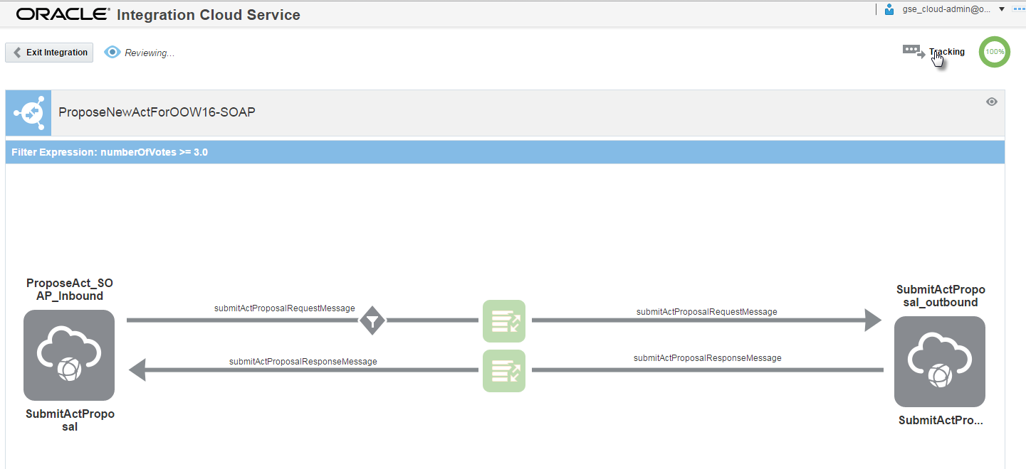
Integration: expose public SOAP, integrate with internal SOA CS

Slide 8
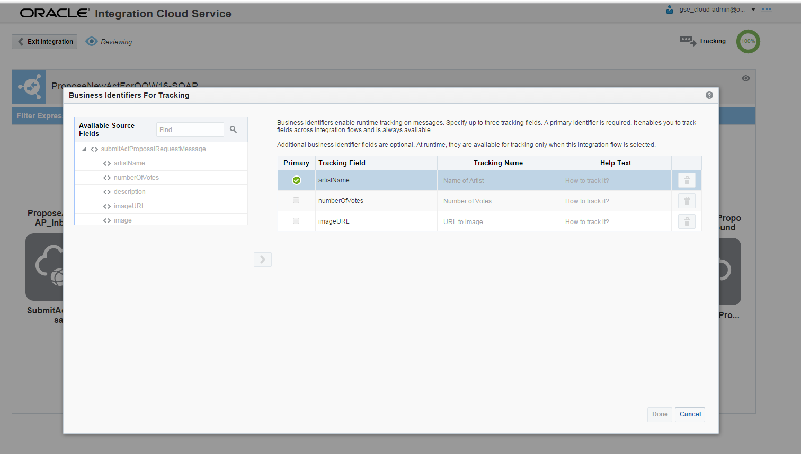
Configure business identifiers

Slide 9
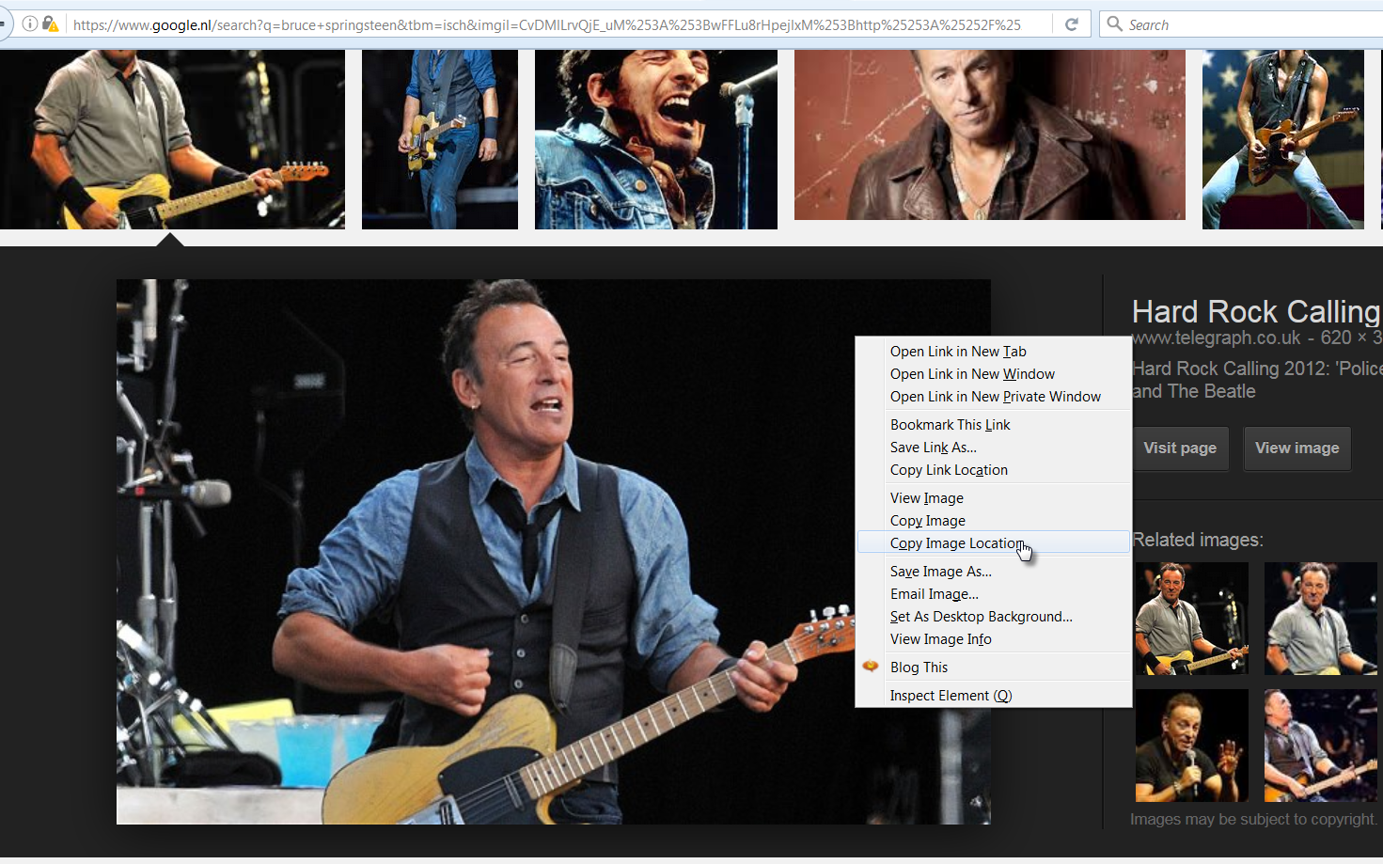
Action: Find a nice The Boss image

Slide 10
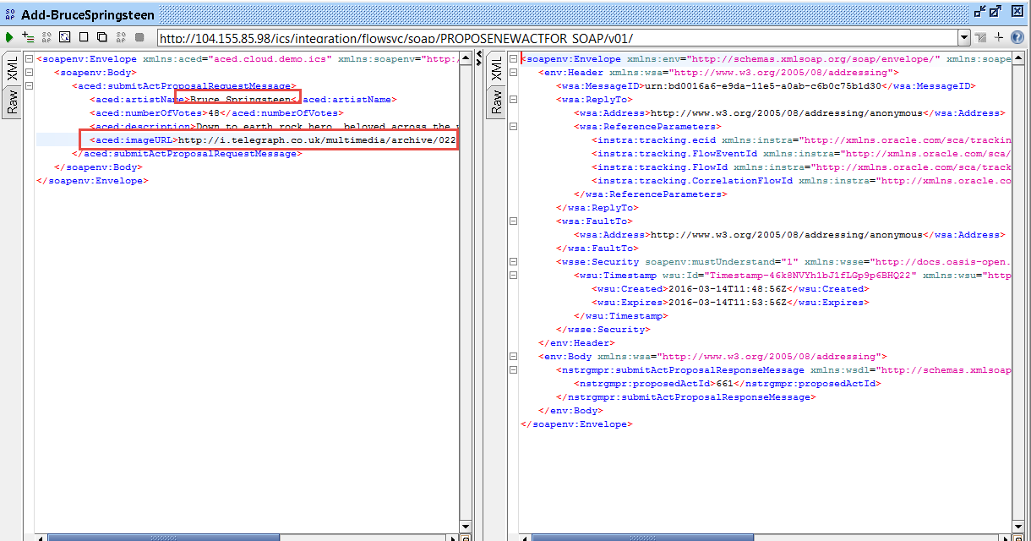
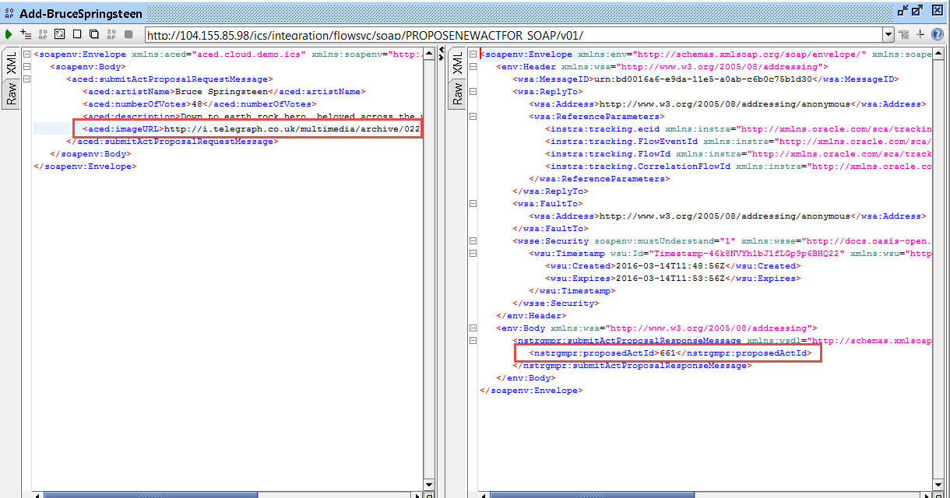
Submit proposal directly to ICS (pretending to be PCS)

Slide 11
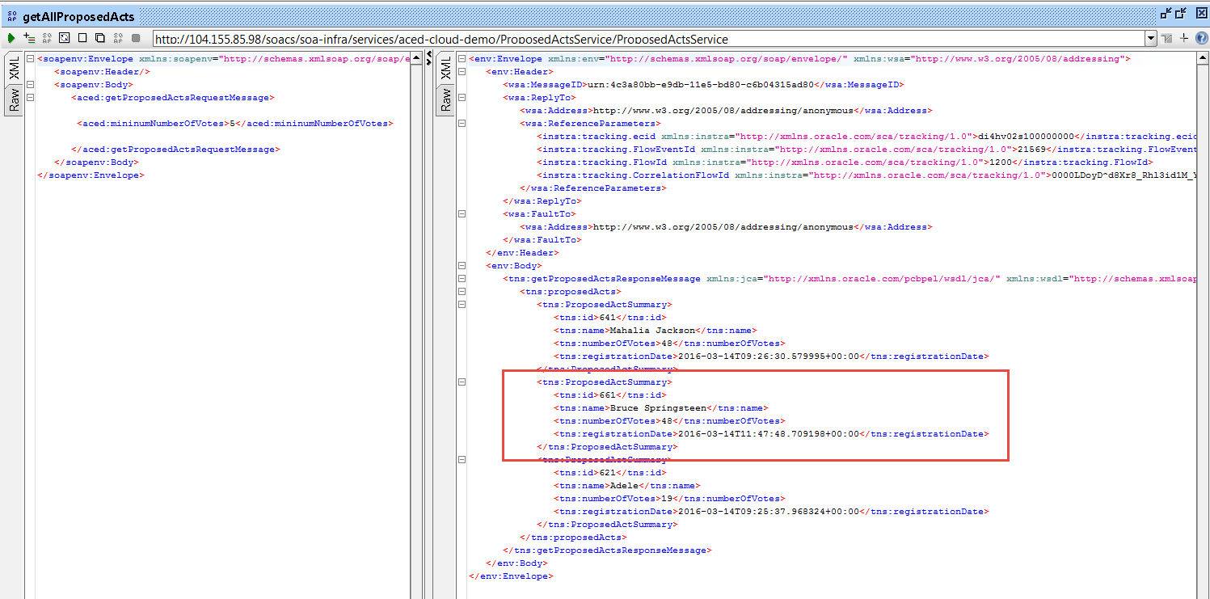
Verified with direct Soap Calls to SOA CS

Slide 12
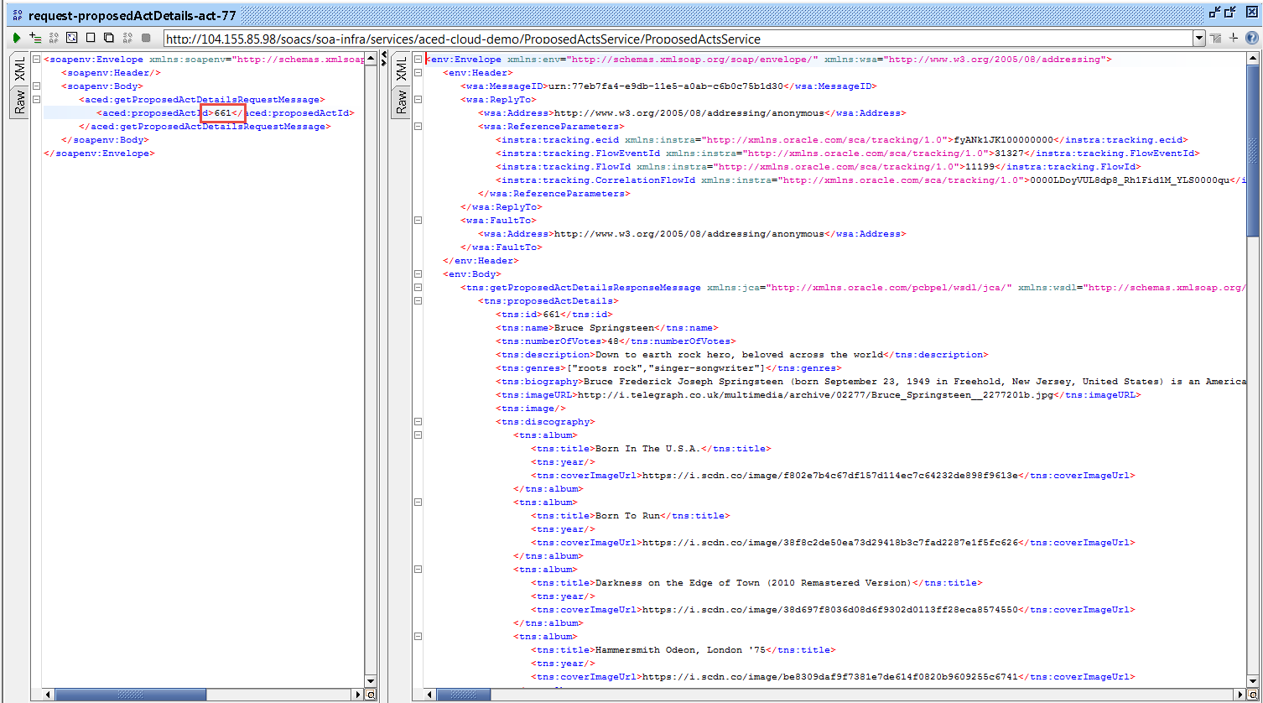
Verified with direct Soap Calls to SOA CS

Slide 13
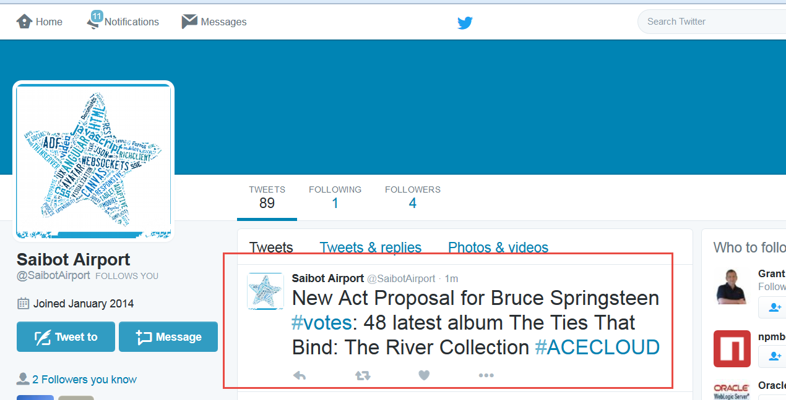
Seconds later…

Slide 14
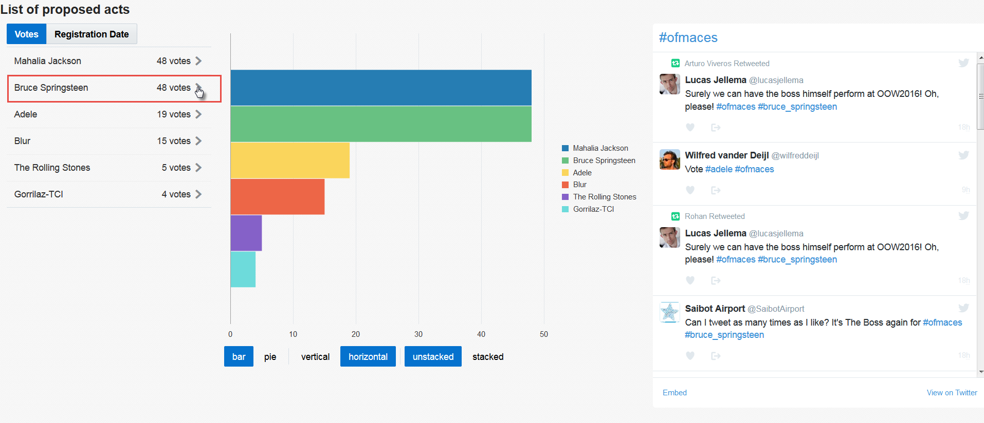
And published in the JET Web App

Slide 15
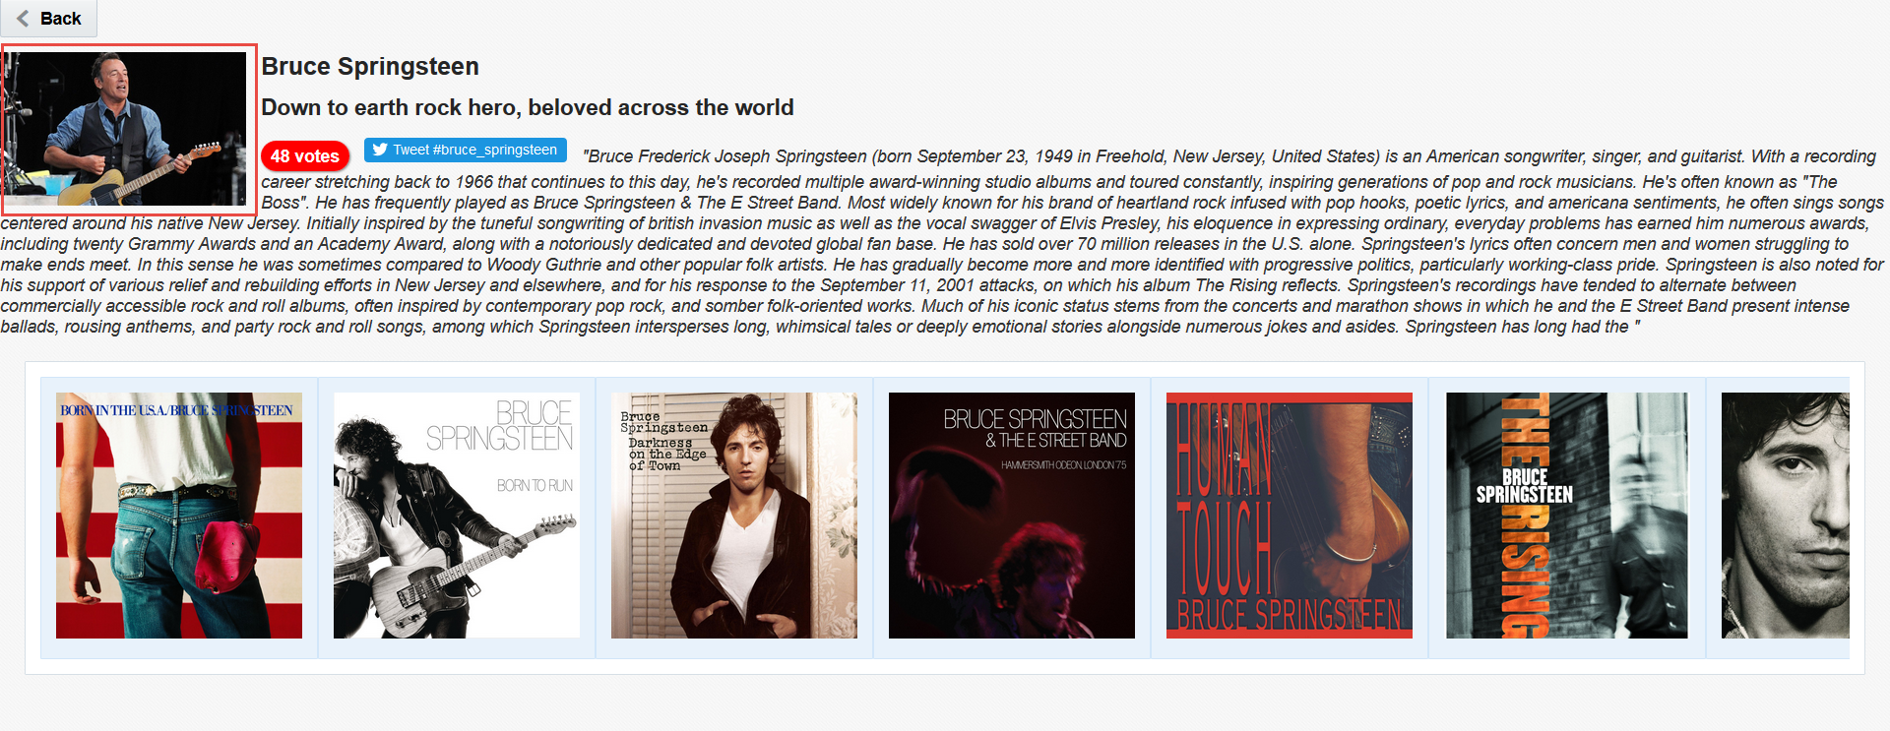
And published in the JET Web App

Slide 16
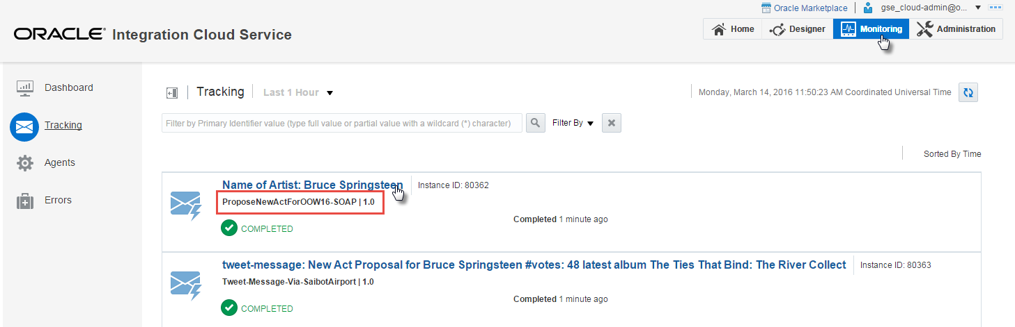
Traces in ICS

Slide 17
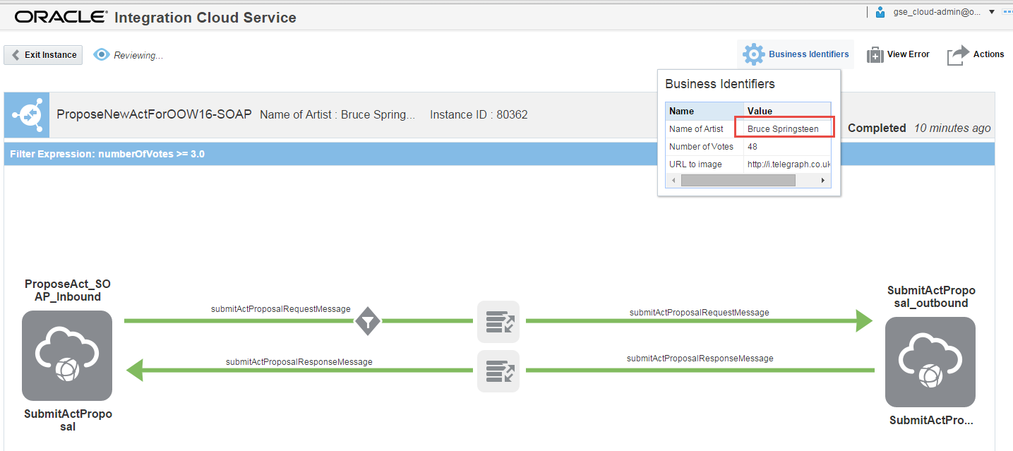
Traces in ICS

Slide 18
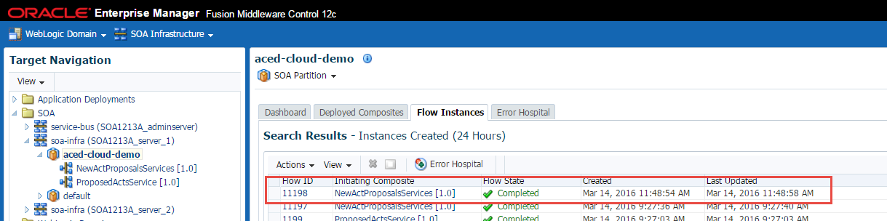
And in SOA CS

Slide 19
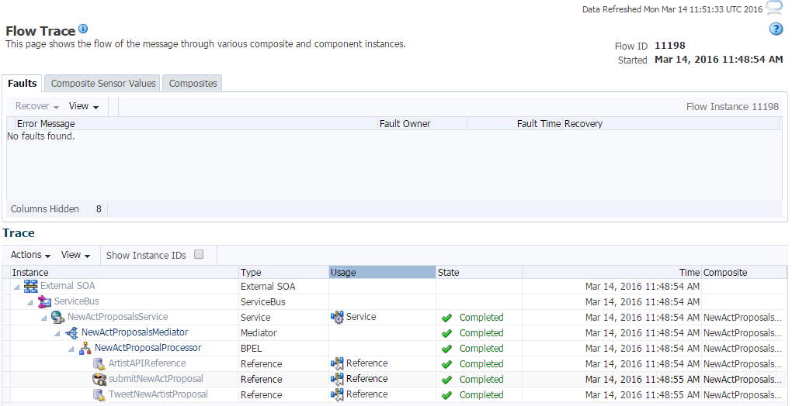
And in SOA CS

Slide 20
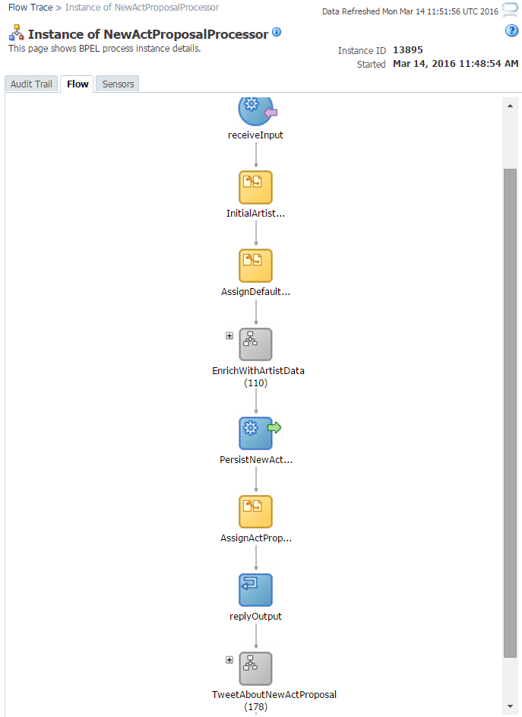
And in SOA CS

Slide 21
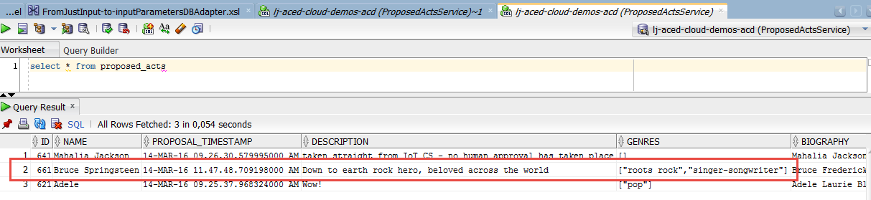
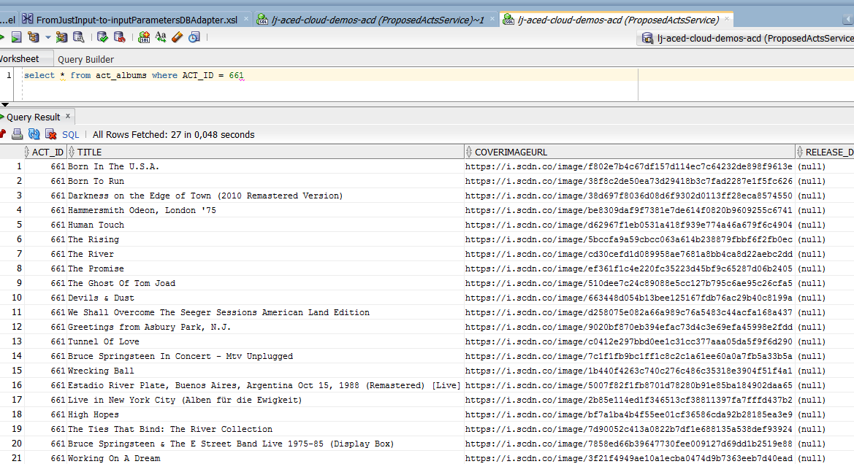
And in DBaaS

Slide 22
SOA CS
Identity Domain
JCS
DBaaS
SOA CS
PDB1
PDB2
HR
APP
Service Bus
SOA
Storage CS
Compute CS

Slide 23
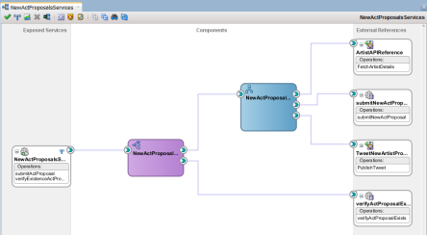
JCS
SOA CS
DBaaS
SOA CS
SOA CS
PDB1
SOA
HR
Service Bus
act_proposal_api
proposed_acts
PDB2
act_albums
APP

